Slide 1
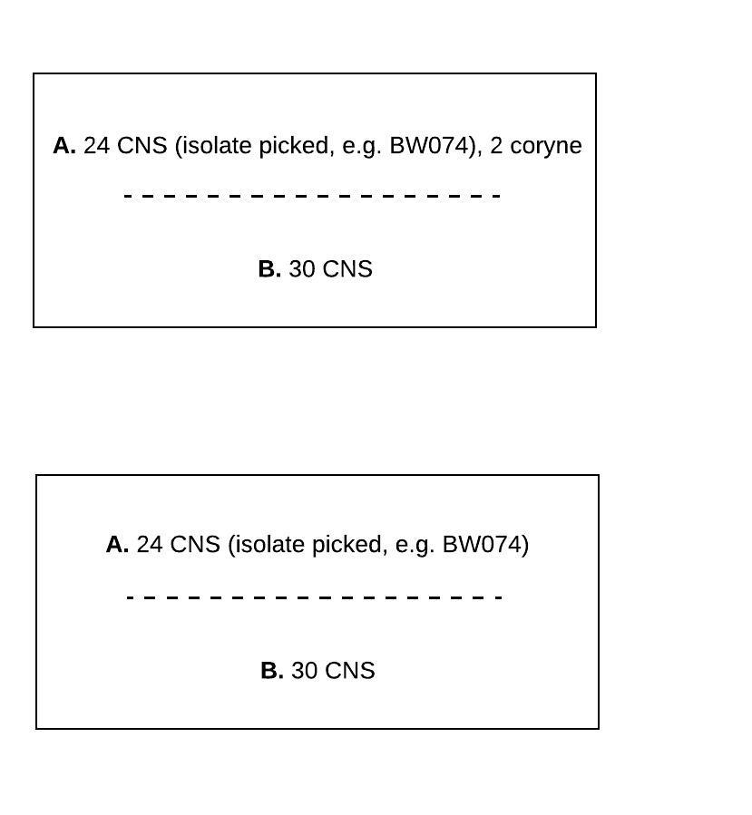
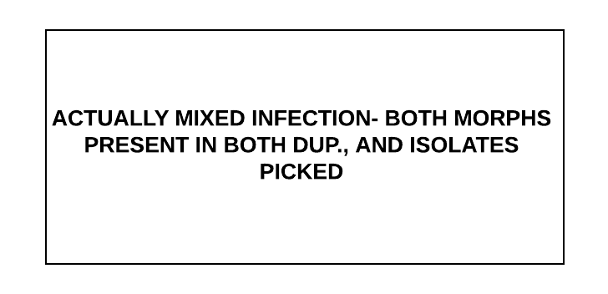
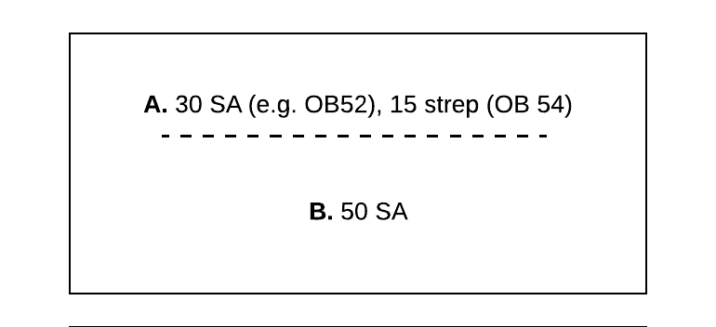
IMI attributable to BW074
(if interpreting in series)
Isolate was present in both duplicates AND fewer than 3 types of different morphs total which would = “contam;” AND “minor growth (less than 3 CFU) of something else present in one or both duplicates (no isolate of second org picked) OR a different isolate picked from one or both duplicates
1
Isolate was present in both duplicates, no other growth
2
Will be single in series, double/mixed in parallel
29
27

Slide 2
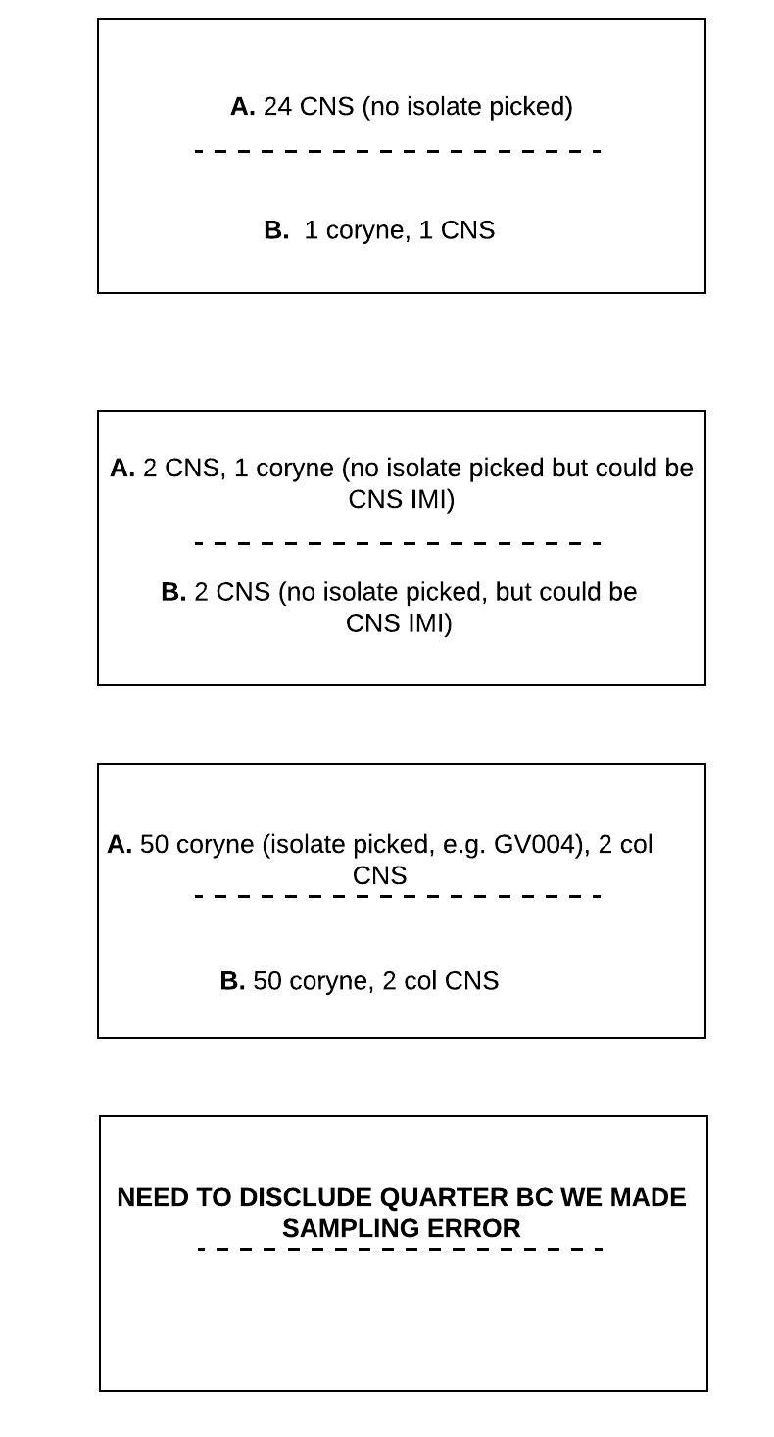
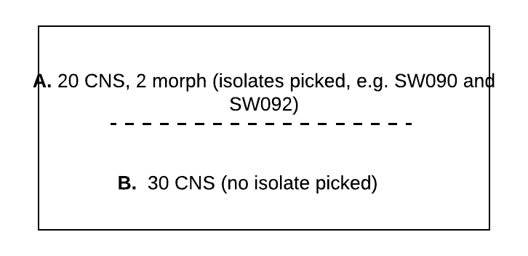
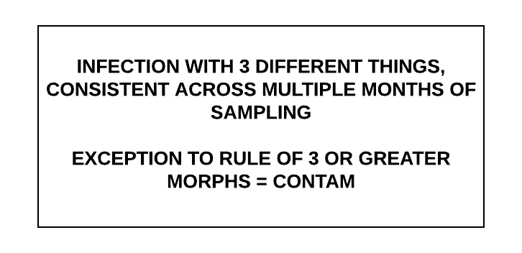
21
Series: CNS technically could be “IMI,” but missed picking second isolate; arguably NSG. Affects mixed infection yes/no
Parallel: not an “IMI” if use rule of ≥3 CFU of 1 morph in one dup; questionable as NSG?
Series: YES IMI and is CNS IMI but don’t know which isolate to attribute to
Parallel: yes IMI CNS, can’t tell if mixed
35
WILL CALL AS IMI but note that is special circumstance
24

Slide 3
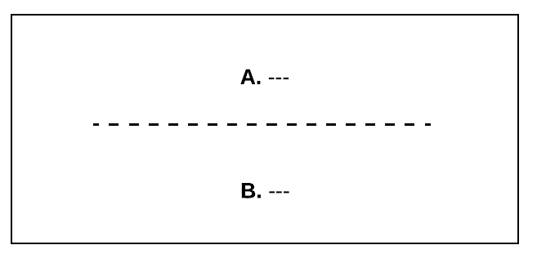
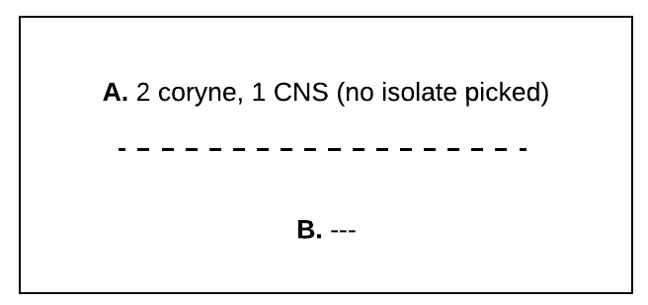
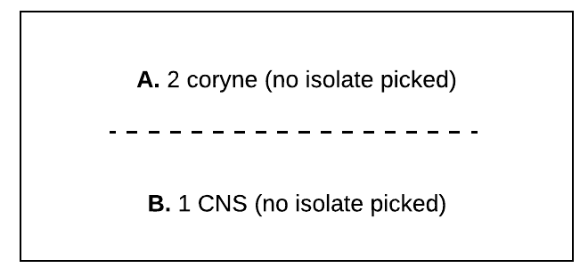
“Negative” for IMI
3
5
≤2 CFU of each morph in ONE dup, NG in other, or just molds in 1
6
≤2 CFU of each morph in BOTH dup, NOT SAME ORG
Would classify at this time (in series) as “No significant growth” NOT SAME ORG on both duplicates, AND fewer than 3 CFU of one morph

Slide 4
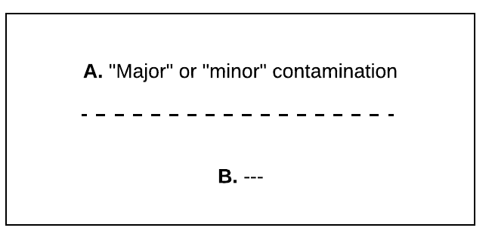
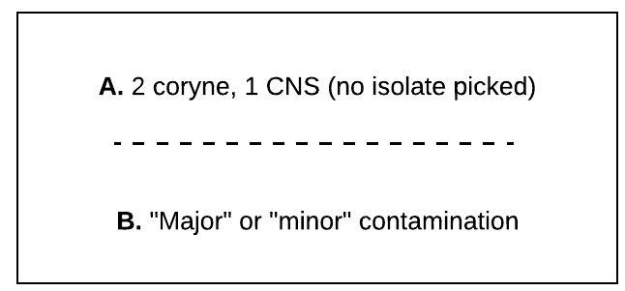
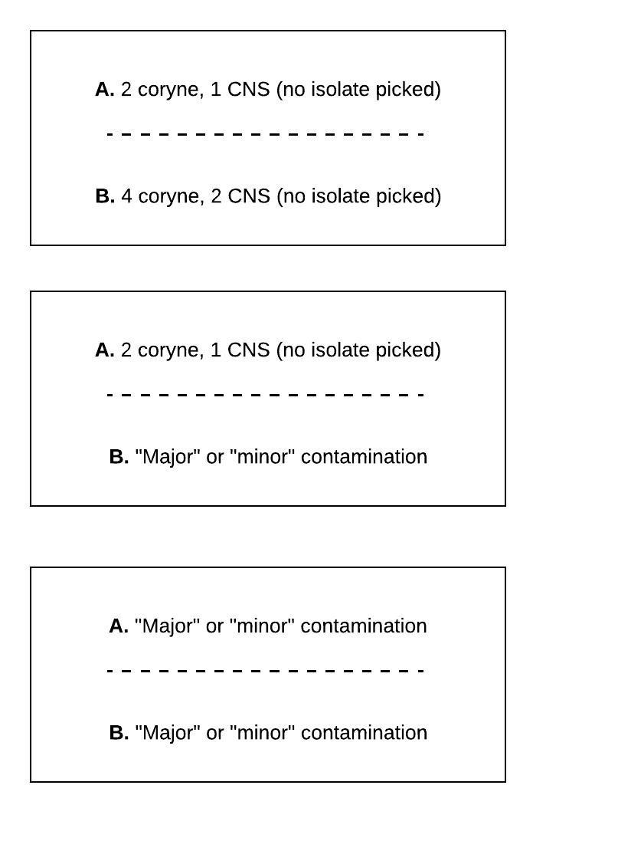
“Contaminated”
4
“contam” if ≥3 morphs
7
Can’t say if IMI present or absent; could be CNS IMI hiding, but could also be no significant growth
8
Sample clearly contaminated

Slide 5
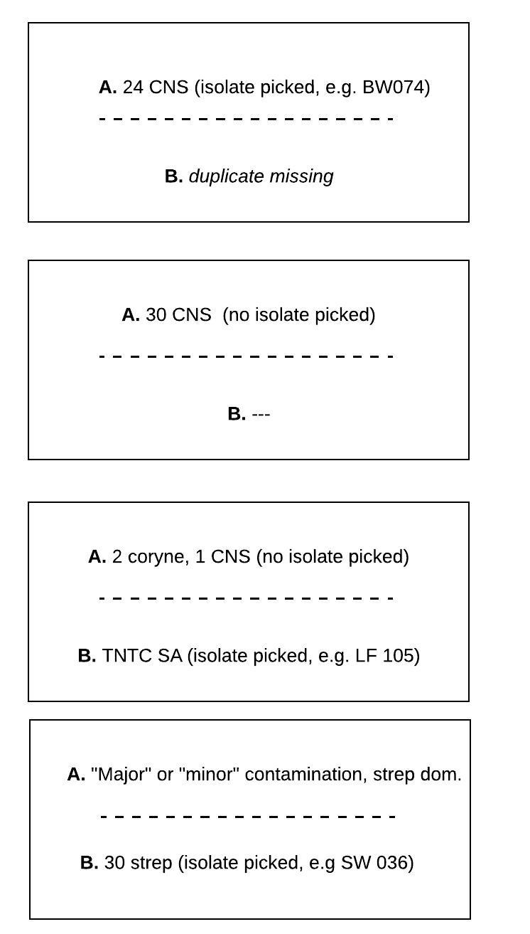
“Other”
≥3 CFU of 1 morph in one dup YES in parallel
Series: have to say “no IMI,” but also doesn’t fit in above categories
Parallel: would call positive for IMI, and can ID causative pathogen
9
≥3 CFU of 1 morph in one dup YES in parallel
Series: have to say “no IMI,” but also doesn’t fit in above categories
Parallel: would call positive for CNS IMI (≥3 CFU of 1 thing in one dup), but need to treat specially in analysis bc can’t ID causative pathogen (vs. 17)
10
≥3 CFU of 1 morph in one dup YES in parallel
11
Series: have to say “no IMI,” but also doesn’t fit in above categories
Parallel: would call positive for IMI of SA (≥3 CFU of 1 thing in one dup), and CAN ID causative pathogen (vs. 23)
12
Series: have to say “no IMI,” but also doesn’t fit in above categories
Parallel: maybe call positive for IMI? Or is it contam?

Slide 6
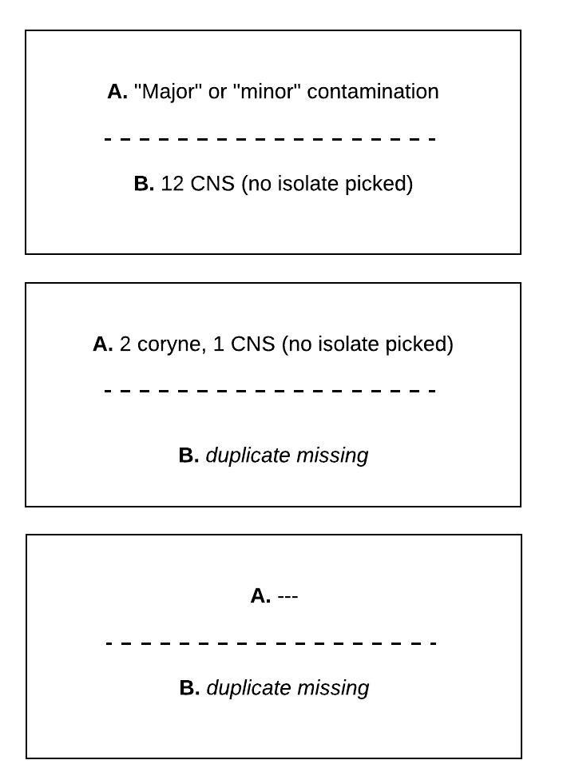
“Other”
≥3 CFU of 1 morph in one dup YES in parallel
Series: not “IMI,” or “Negative;” arguably “Contaminated?”
Parallel: could call positive for IMI (≥3 CFU of 1 morph in one dup), or contam?, but can’t attribute to an organism (similar to 12 but no ID done)
13
Series: not “IMI,” not “Negative” bc might be hiding CNS or coryne IMI; arguably “NSG” or “Contaminated”
Parallel: let’s say “NO” bc less than 3 CFU of one morph; can’t attribute to an organism (no ID done)
14
Series: not “IMI,” or “Negative;” ?
Parallel: Need to disclude? Could be anything!
15

Slide 7
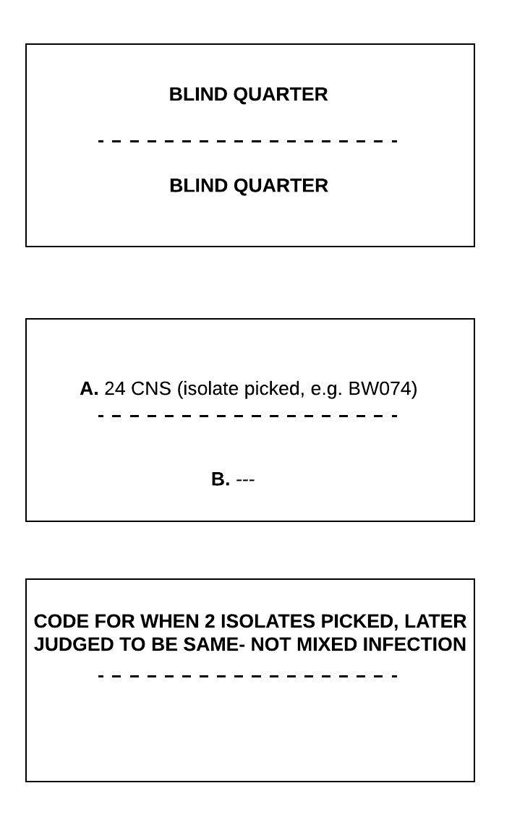
“Other”
16
≥3 CFU of 1 morph in one dup YES in parallel
Series: “no IMI”
Parallel: would call positive for CNS IMI (≥3 CFU of 1 thing in one dup), and CAN ID causative pathogen (vs. 10)
17
Really for the column with explanation of IMI status path1 or path2- example: LF56 and 57 from Faith, 1.29.20, in RH- two isolates saved, in retrospect judged to be same thing causing IMI, so enter “other18” as code in “path2 IMI” column
18

Slide 8
“Other”
TECHNICALLY yes IMI in series, but missed picking isolate; ≥3 CFU of 1 morph in at least one dup
19
Series: technically yes CNS IMI in series, but need to treat specially bc can’t ID causative pathogen
Parallel: would call positive for IMI, but need to treat specially bc can’t ID causative pathogen
≤2 CFU of each morph in both dup, NSG? TECHNICALLY IMI in series, missed picking isolate
Series: technically yes an “IMI,” but didn’t pick isolate; questionable as NSG?
Parallel: not an “IMI” if use rule of ≥3 CFU of 1 morph in one dup; questionable as NSG?
20
22
Pretty clear from looking at previous or next sampling, or mismatch between duplicates, that there was sampling error. Need to disclude from analysis. I.e. OB Ginger, third visit, RH

Slide 9
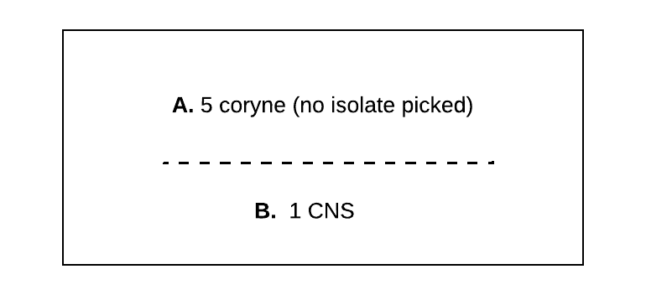
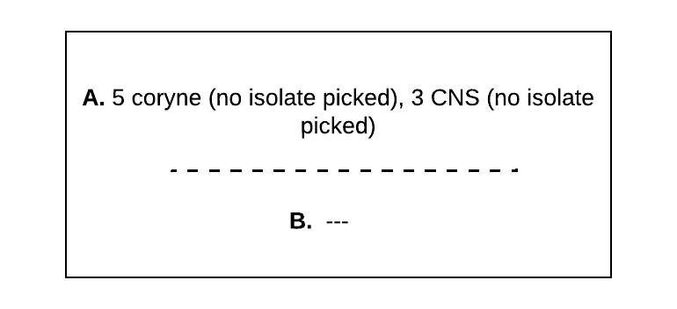
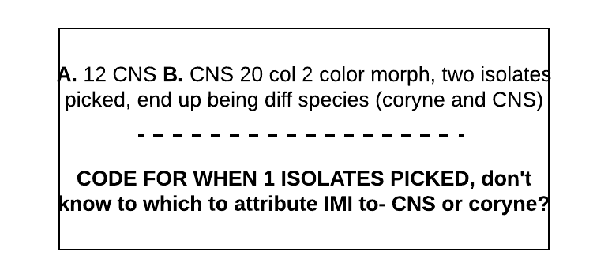
≥3 CFU of 1 morph in one dup YES in parallel
Series: have to say “no IMI,” but also doesn’t fit in above categories
Parallel: would call positive for IMI of coryne (≥3 CFU of 1 thing in one dup), but need to treat specially in analysis bc can’t ID causative pathogen (vs. 11)
23
“Other”
≥3 CFU of 1 morph in one dup YES in parallel, MIXED
Series: have to say “no IMI,” but also doesn’t fit in above categories
Parallel: would call positive for IMI of coryne (≥3 CFU of 1 thing in one dup) AND CNS, but need to treat specially in analysis bc can’t ID causative pathogen (vs. 11). Same as 23 but “mixed”
25
26
WILL CALL AS IMI but can’t attribute to species? Or know if mixed or not

Slide 10
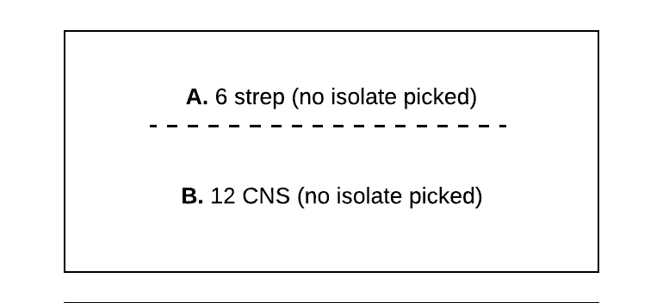
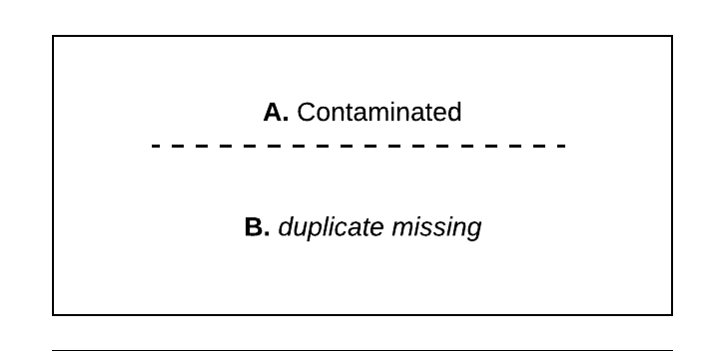
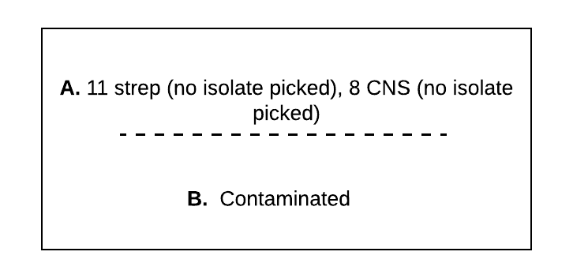
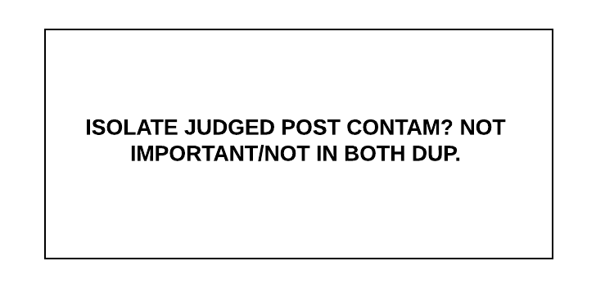
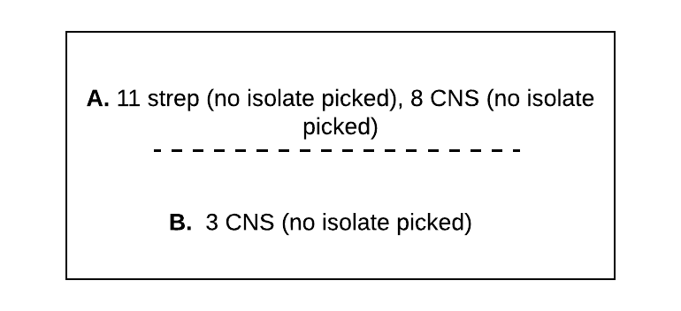
Series: have to say “no IMI,” but also doesn’t fit in above categories
Parallel: would call positive for IMI of BOTH (≥3 CFU of 1 thing in one dup), but need to treat specially in analysis bc can’t ID causative pathogen- so 2 IMI
28
Parallel: would call mixed inf for IMI of BOTH (≥3 CFU of 1 thing in one dup) BUT need to treat specially in analysis bc can’t ID causative pathogen
30
33
Series: no IMI
Parallel: would call positive for IMI of BOTH (≥3 CFU of 1 thing in one dup), and first dup. mixed- BUT need to treat specially in analysis bc can’t ID causative pathogen (like 29 but no ID)
31
Series: tech “yes” IMI we missed
32

Slide 11
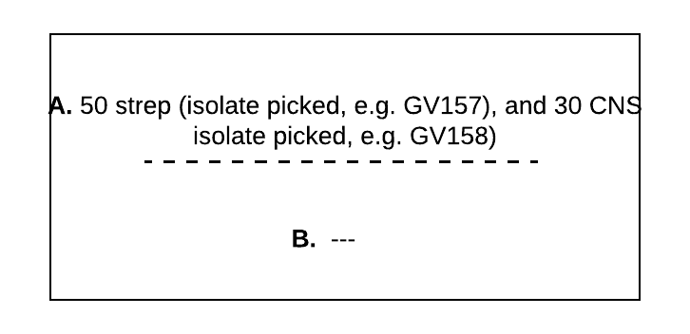
Series: have to say “no IMI,” but also doesn’t fit in above categories
Parallel: would call positive for MIXED IMI (≥3 CFU of 1 thing in one dup), and CAN ID causative pathogen (vs. 25)
34

Slide 13
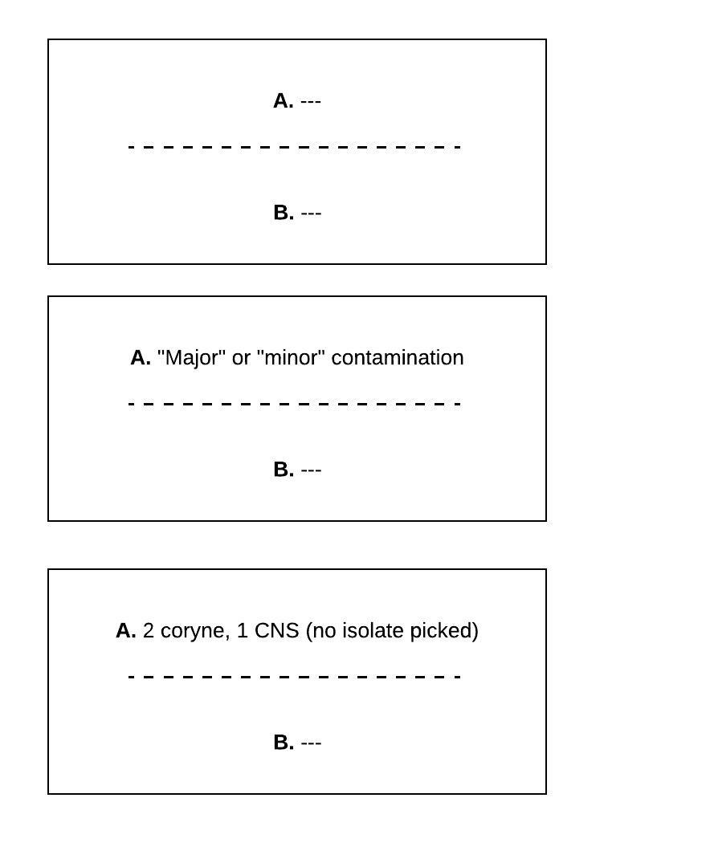
3
“contam” if ≥3 morphs
“Negative” for IMI
4
≤2 CFU of each morph in ONE dup, NG in other, or just molds in 1
5

Slide 14

“NSG/Contaminated”
≤2 CFU of each morph in BOTH dup, NOT SAME ORG
Would classify at this time (in series) as “No significant growth” NOT SAME ORG on both duplicates, AND fewer than 3 CFU of one morph
6
Can’t say if IMI present or absent; could be CNS IMI hiding, but could also be no significant growth
7
Sample clearly contaminated
8

